Slide 1
Quiz Game
By Team 25

Slide 2
CONTENTS
01
02
03
04
Introduction
Tech Stack
Brief Introduction about the project
Technologies used for the project
Results
References
Displaying actual results
References and resources used while building project

Slide 3
INTRODUCTION
The course project we built is a Quiz game based on the theme of a popular game show Kaun Banega Crorepati. In this game questions will be asked and on correct answering to the question user will be awarded with money prize . The prize money for each question increases as we go through the gameplay so will be the level of questions asked. To help the user there will be some lifelines provided which can be used once throughout the gameplay. When user choses wrong answer they will be eliminated from the game and will be provided with prize money won till the previous questions answered correctly.

Slide 4
Tech Stack
Technologies Used in this project are
C++ graphics library for implementing animations and graphics.
C++ MMSystem and windows.h libraries for implementing sound and delay functions.
File Management for retrieving questions and options
OOP concepts like class, objects and access specifier

Slide 5

Results

Slide 6
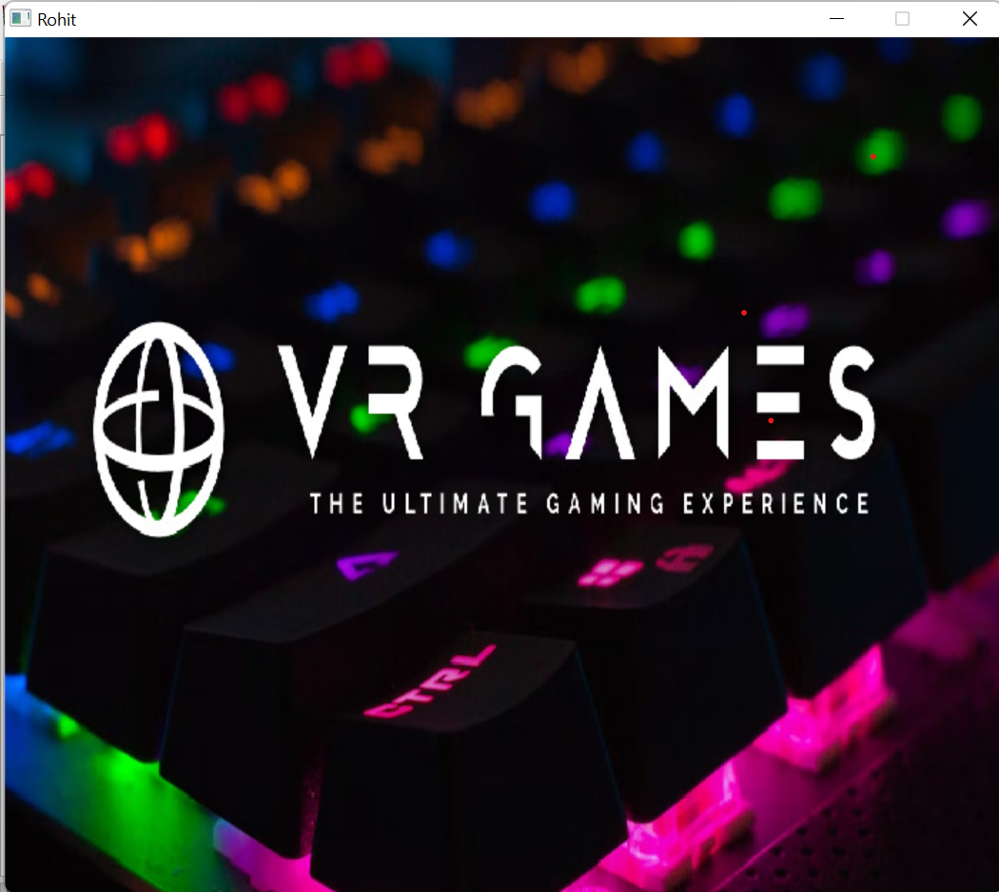
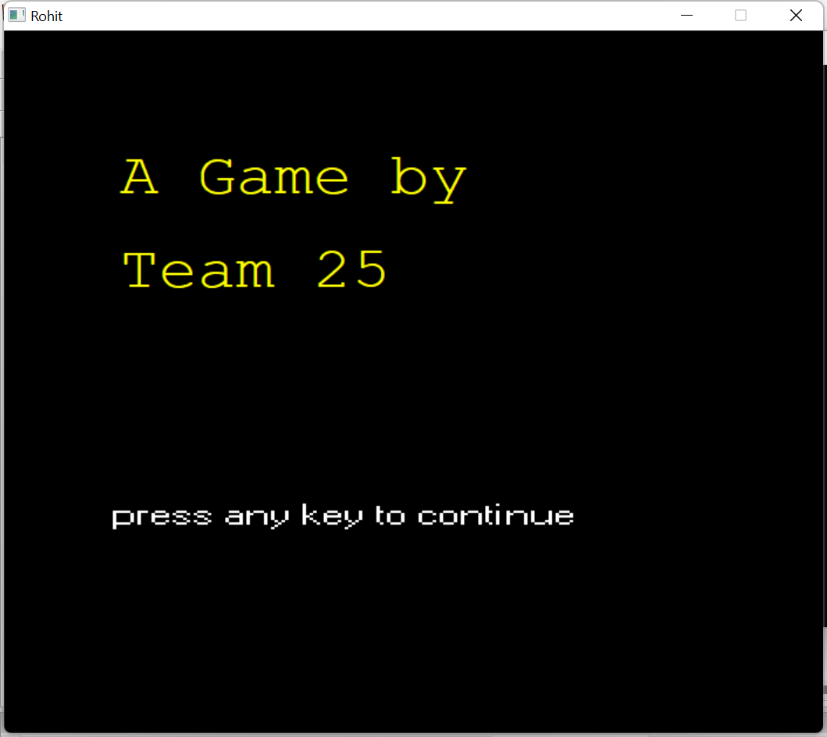

Slide 7
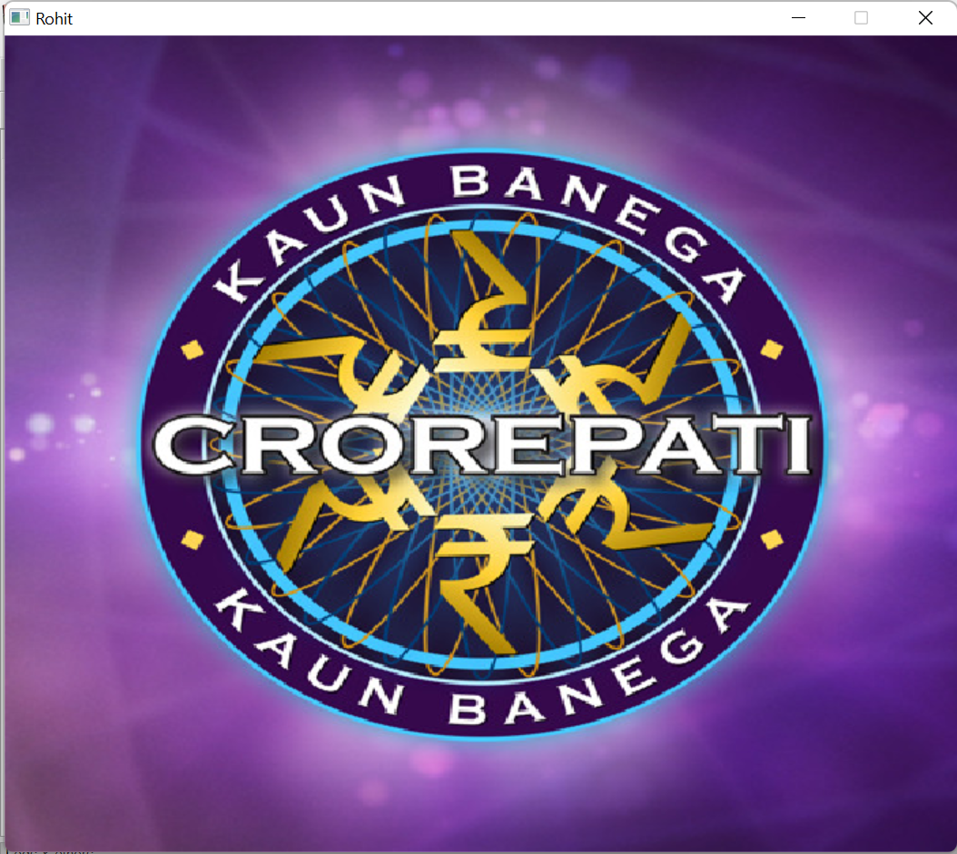
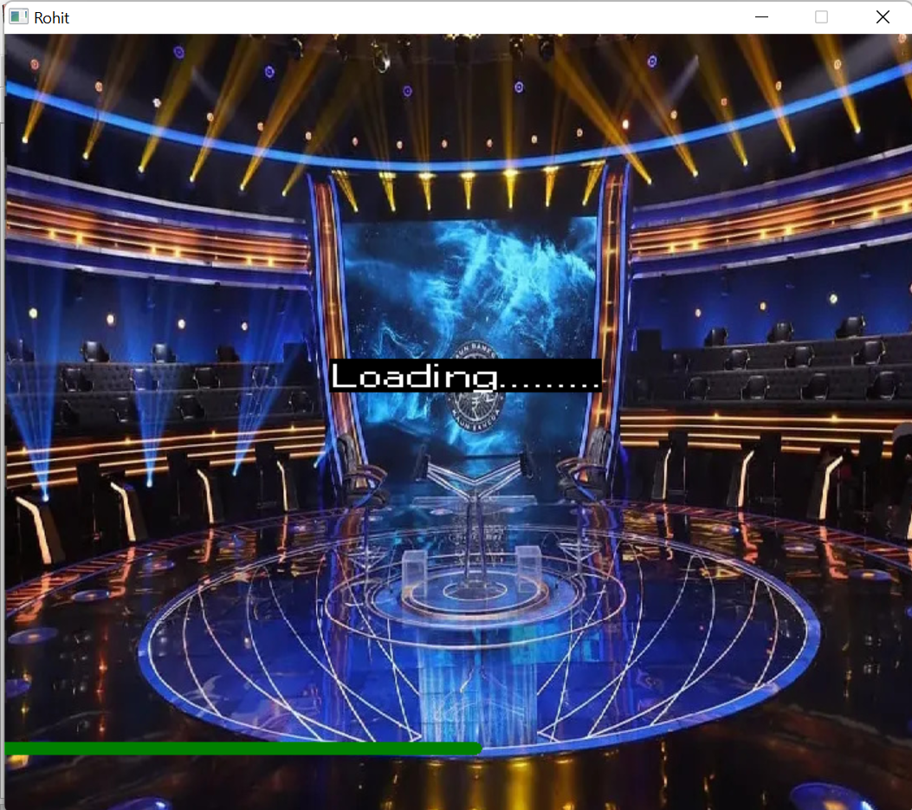

Slide 8
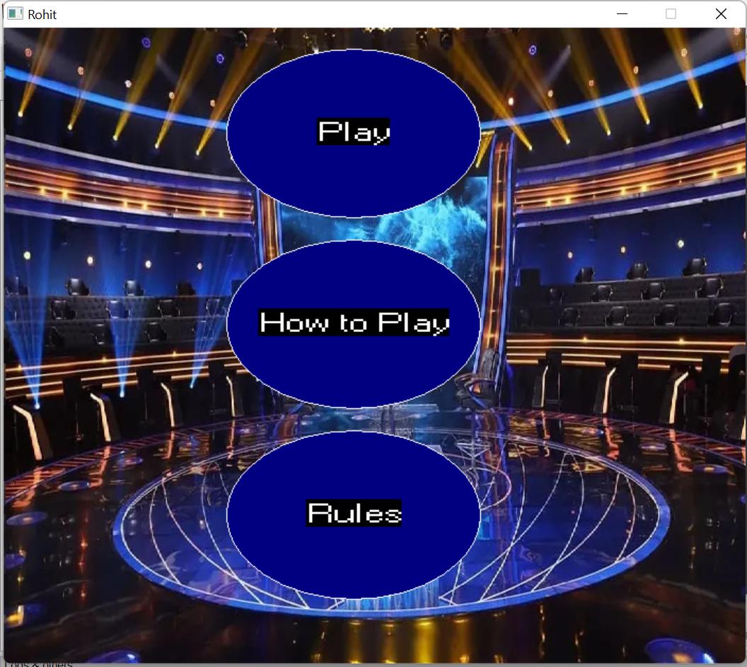
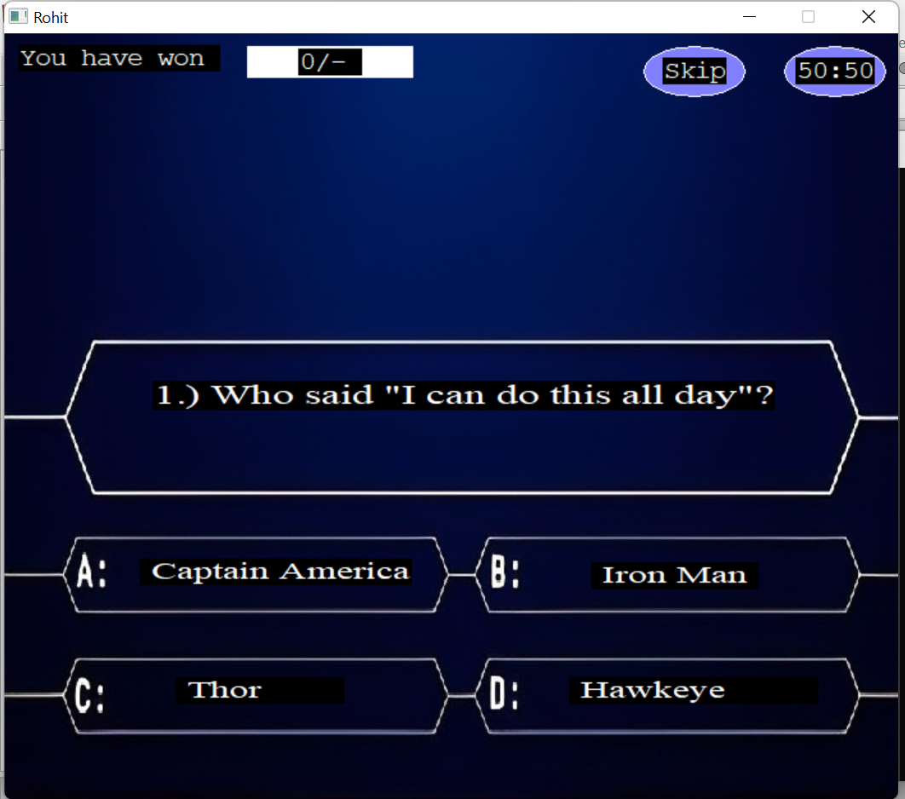

Slide 9
References
https://home.cs.colorado.edu/~main/bgi/doc/index.html
https://developerinsider.co/graphics-graphics-h-c-programming/
Resources
YouTube
stackoverflow
BGI Graphics Documentation

Slide 10
Thank You

